Slide 1

AI BASED SMART CAREER COUNSELLING
2023
~AN OVERVIEW

Slide 2
Problem Description
Ministry : Ministry of Education
PS Code : SIH1434 Problem Statement : Making career choices and AI based counselling accessible to every child at secondary level along with aptitude
Team Name : EdXperts
Team Leader : Vijesh Pethuram K
Institute Code(AISHE) : 1-3516234145
Institute Name : Mepco Schlenk Engineering College
Theme : Education
tests and detailed career paths.

Slide 3


Team Members Details
Team Member Name | Branch | Stream
Vijesh Pethuram K (Leader) | Bachelor of Technology | Information Technology
Prabhu R | Bachelor of Technology | Information Technology
Vignesh S | Bachelor of Technology | Information Technology
Sanchith R S | Bachelor of Technology | Information Technology
Abinaya S M | Bachelor of Technology | Information Technology
Deepalakshmi N J S | Bachelor of Technology | Information Technology
Mentor Name | Category | Expertise Domain | Domain Experience
Dr. G. Yogarajan | Academic | Networking | 18 years

Slide 4
Proposed Ideas
To Recommend a suitable career for the students based on Aptitude Tests and previous marks. To create a Chatbot and make it interact with students through which his/her careers are predicted and refined. To have real-time career insights and provide career suggestions based on it.

Slide 5




Use cases
Students will receive a report that explains their aptitude test results and provides suggestions for careers that are a good fit for them.
Real time career insights and providing career suggestions based on it.
The student then chats with a chatbot to discuss their results and explore different career options.
The student uses the information to make their career choices and make a decision about their future.

Slide 6
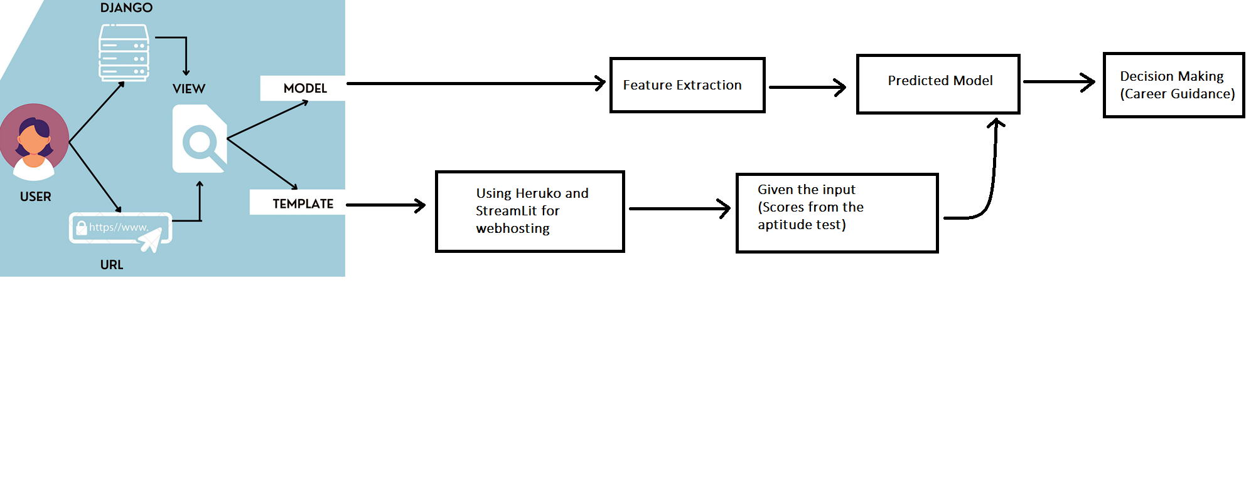
Flow chart of Frontend Development

Slide 7
Flow chart of System Design(Backend) for analysis of Interest and marks of the students
Extraction of Marks
Supervised Learning Algorithm
Dataset
combine
Extraction of other activities(Interest)
Unsupervised Learning
Algorithm
Output
combine
Feature Extraction(Provided real time career Insights)
Interaction with ChatBot

Slide 8
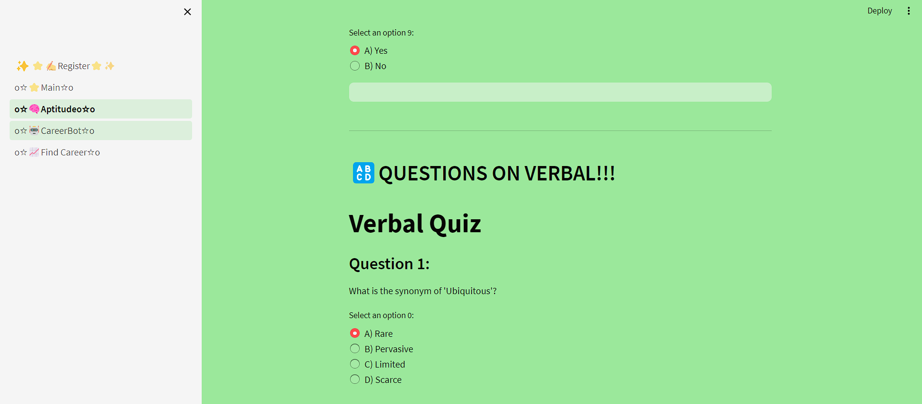
Prototype

Slide 9
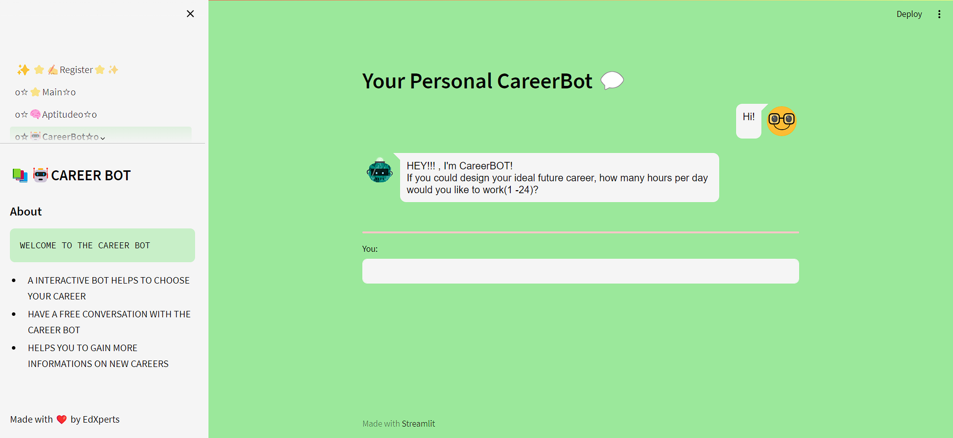
CAREER
BOT

Slide 10

YEAH!!

Slide 11

Thank You!!!

